Slide 1




International Radio Days 2025
Facing the future of audio journalism
Blended Intensive Programme powered by
Partner:

Slide 2
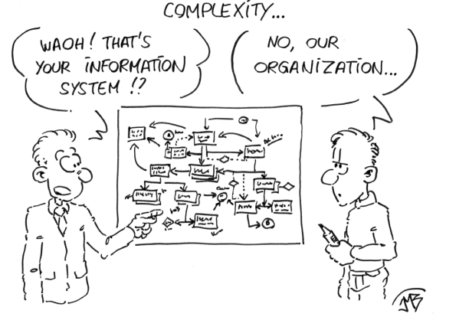
organizational:
Place: Campus & City Radio St. Pölten (CR 94.4)
UAS St. Pölten, 3100 St. Pölten, Campusplatz 1, Austria
Credits: 3 ECTS/2 SWS
Wann: Onlinepart: 5 lectures, each 3 teaching units between 1st of April
and 7th of May (dates tbd)
Attendance week St. Pölten from 11th to 17th of May 2025
Language: English/German
Management team: René Anderl (UAS Würzburg), Andreas Krättli (Uni Liechtenstein), Ewald Volk (UAS St. Pölten)
"Dieses Foto" von Unbekannter Autor ist lizenziert gemäß CC BY-NC-ND

Slide 3
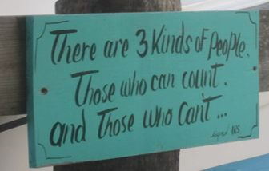
Content virtual part/Online
1. Teambuilding: René Anderl
2. Writing for listening - finding topics – concepts for radio shows/podcast: Ewald Volk
(Task: submit concept before attendance week)
3. Research: René Anderl
4. How to present in radio/Voice training: Andreas Krättli
5. Interview training: Andreas Krättli
(Task: Submission of first audios before attendance week)
Credits: Ewald Volk

Slide 4
Content attendance week
Feedback on concepts and audios from the online sessions
Presenting a live broadcast on Campus & City Radio St. Pölten (CR 94.4)
Feature design for audio
Presenting in radio broadcasted live
Radio history
Creating a pre-produced radio show/podcast with a journalistic focus
Participation in editorial conference CR 94.4
Practical teaching of skills in the areas of designing radio reports, editing, presenting in radio
broadcasting technology on various plattforms
field trips and excursions
Guest lectures in future of audio
The students' radio shows/podcasts are broadcast by CR 94.4 and are available in the showreel archive of the students' media productions.

Slide 5


Planned field trips & excursions
Field trips to radio stations:
- Bauer Media Group Bratislava
Headquarter for Central Europe, 4 slovak radio stations at site
(Radio Expres, Europa 2, Rádio Rock and Rádio Melody and podcast platform Podmaz.sk )
- Kronehit Vienna
No 1 private radio station in Austria
- Radio Orange Vienna
No 1 community radio in Austria
Excursions:
guided city tours in St. Pölten and Bratislava

Slide 6
Schedule attendance week

Slide 7
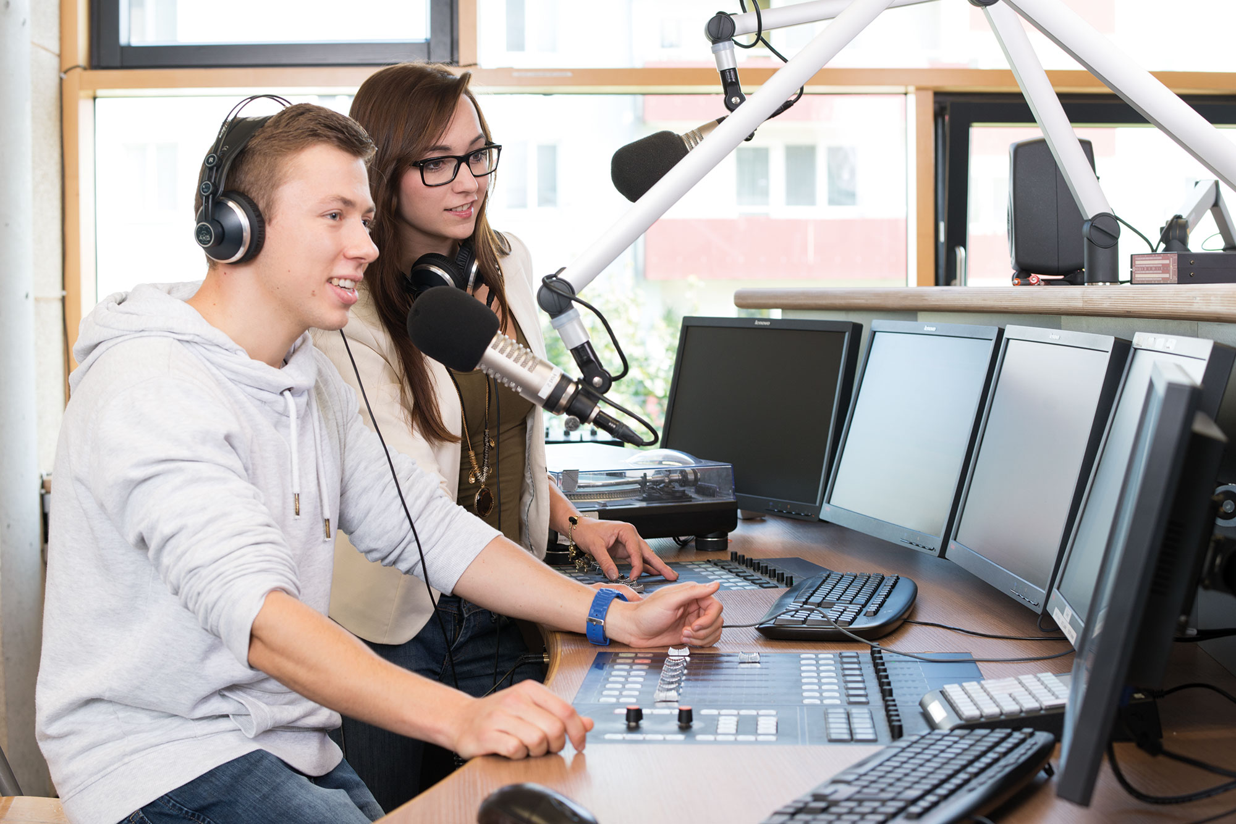


Presentation of Campus & Cityradio St. Pölten – CR 94.4
Both educational and community radio – broadcasting since 2002
Broadcasts 24/7 on the FM frequency 94.4 (broadcast area of ​​central Lower Austria with technical reach of approx. 100,000) as well as simulcast online stream. Broadcasts and podcasts available from the Cultural Broadcast Archive
Management: Ewald Volk
Program manager: Margit Wolfsberger
Head of community radio: Klaus Temper
Features/equipment: equivalent to a large commercial radio with the latest hardware and software
Credits: FH St. Pölten

Slide 8

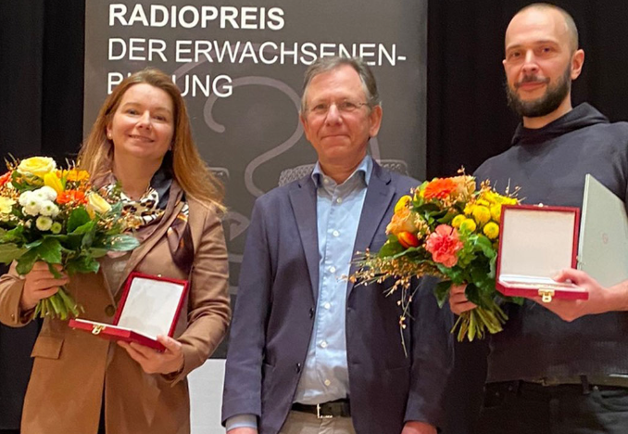
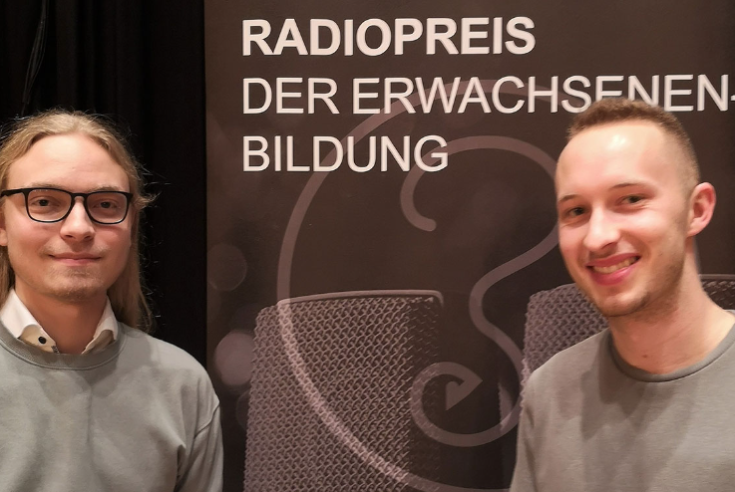
Information on
Credits: Amrai Stanzel / Radio Orange
Adult Education Radio Award 2021 + 2022
We are now also winning industry awards with our shows
Credits: Anna Michalski

Slide 9
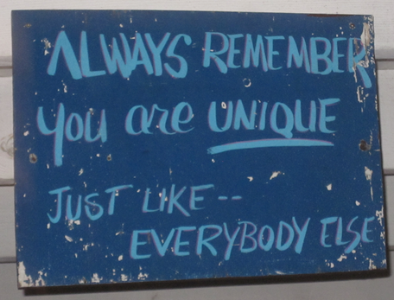
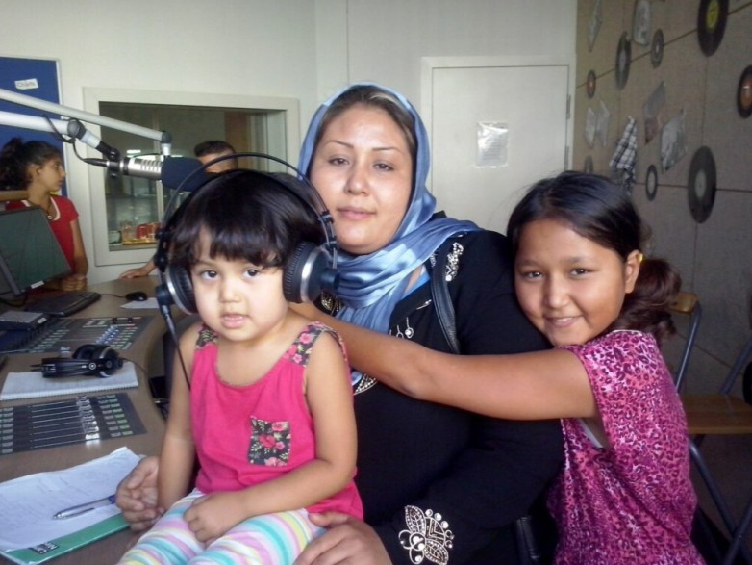
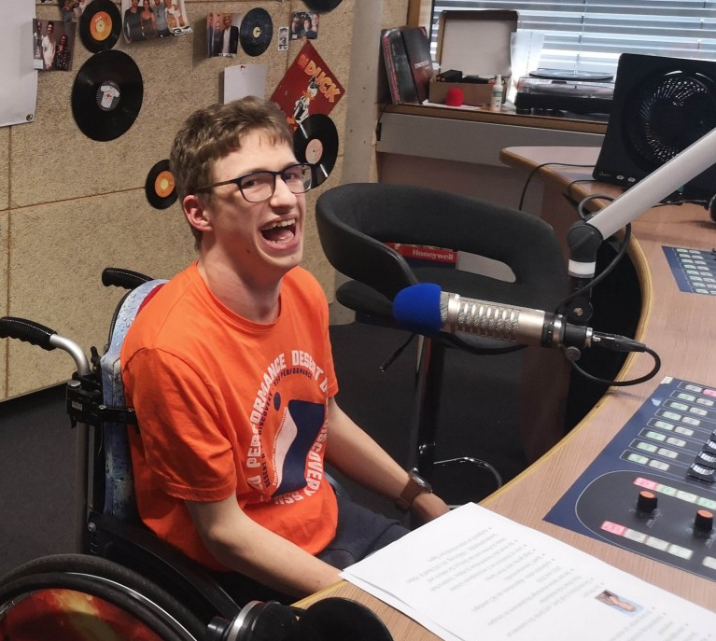
Information on:
Credits: Ewald Volk
We attach great importance to diversity and accessibility
Credits: Haslinger-Maierhofer
Credits: Anna Michalski

Slide 10
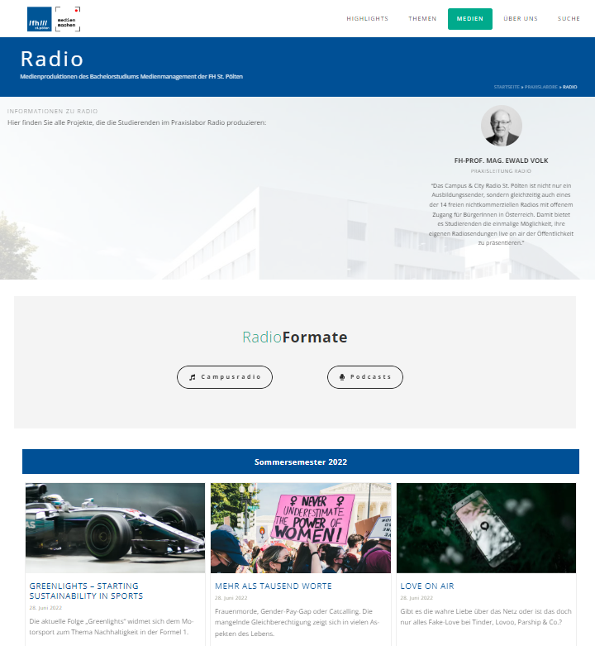
Showreel Bachelor Medienmanagement
Platform for student media productions in the campus media of the St. Pölten University of Applied Sciences

Slide 11
Impressions from previous IRDs

Slide 12
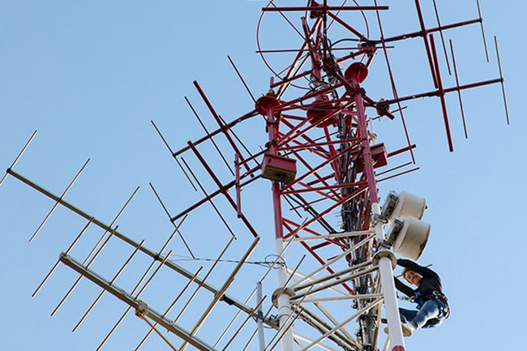
Impressions from previous Radio Days
Students inspection of the Campus Radio transmitter tower
Credits: René Anderl

Slide 13
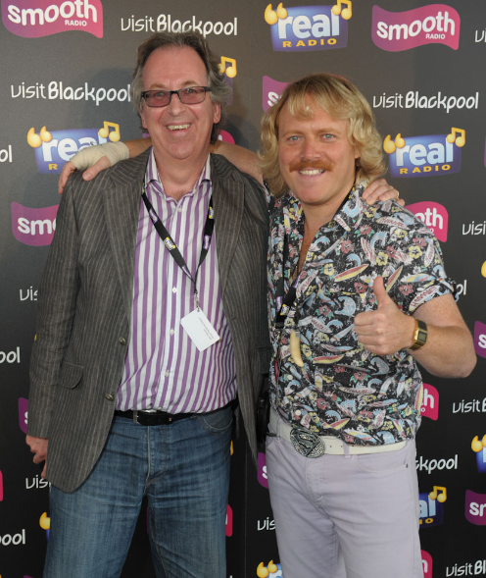
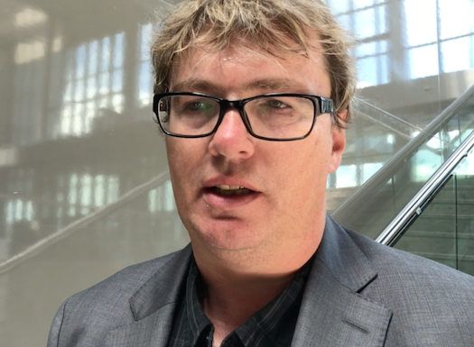
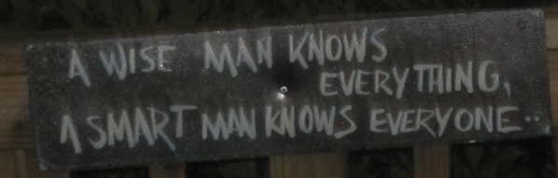
Keynote + Guest lecture
Keynote:
John Simons (international radio consultant and ex BBC DJ)
The top 20 attributes of a great radio presenter - John Simons – YouTube
Guest lecture “Future of Radio”:
Rüdiger Landgraf (Kronehit – Authorized
Representative for Digital & Strategy)
Foto John Simons Consulting
Credits: RadioInfo Asia
Credits: Ewald Volk

Slide 14
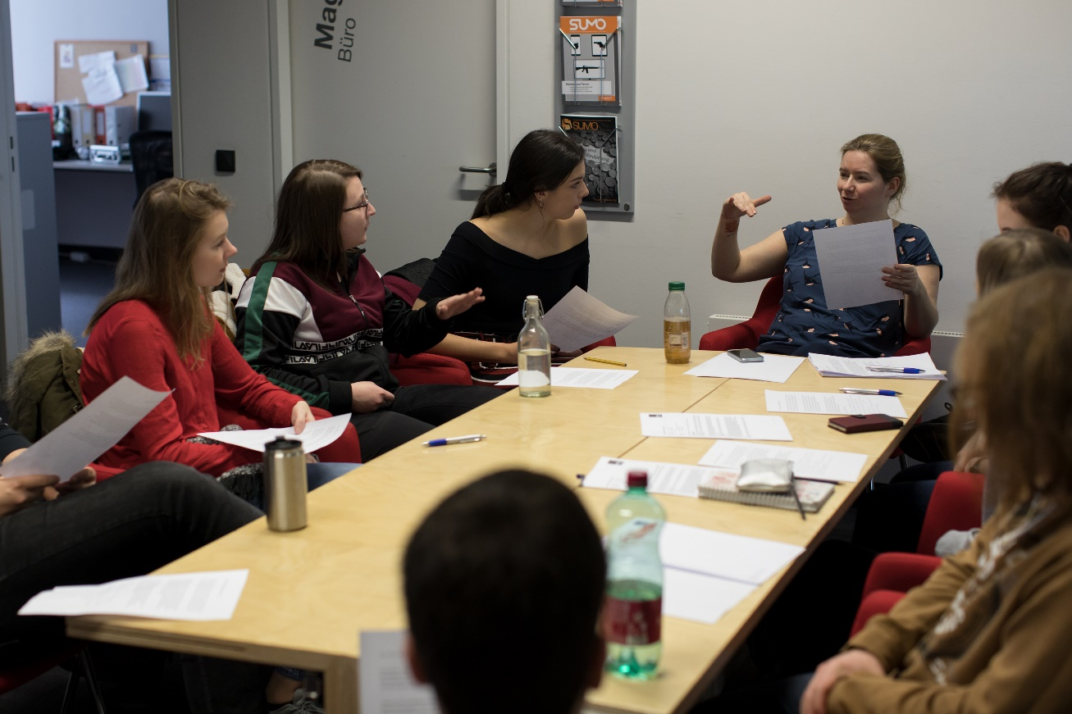
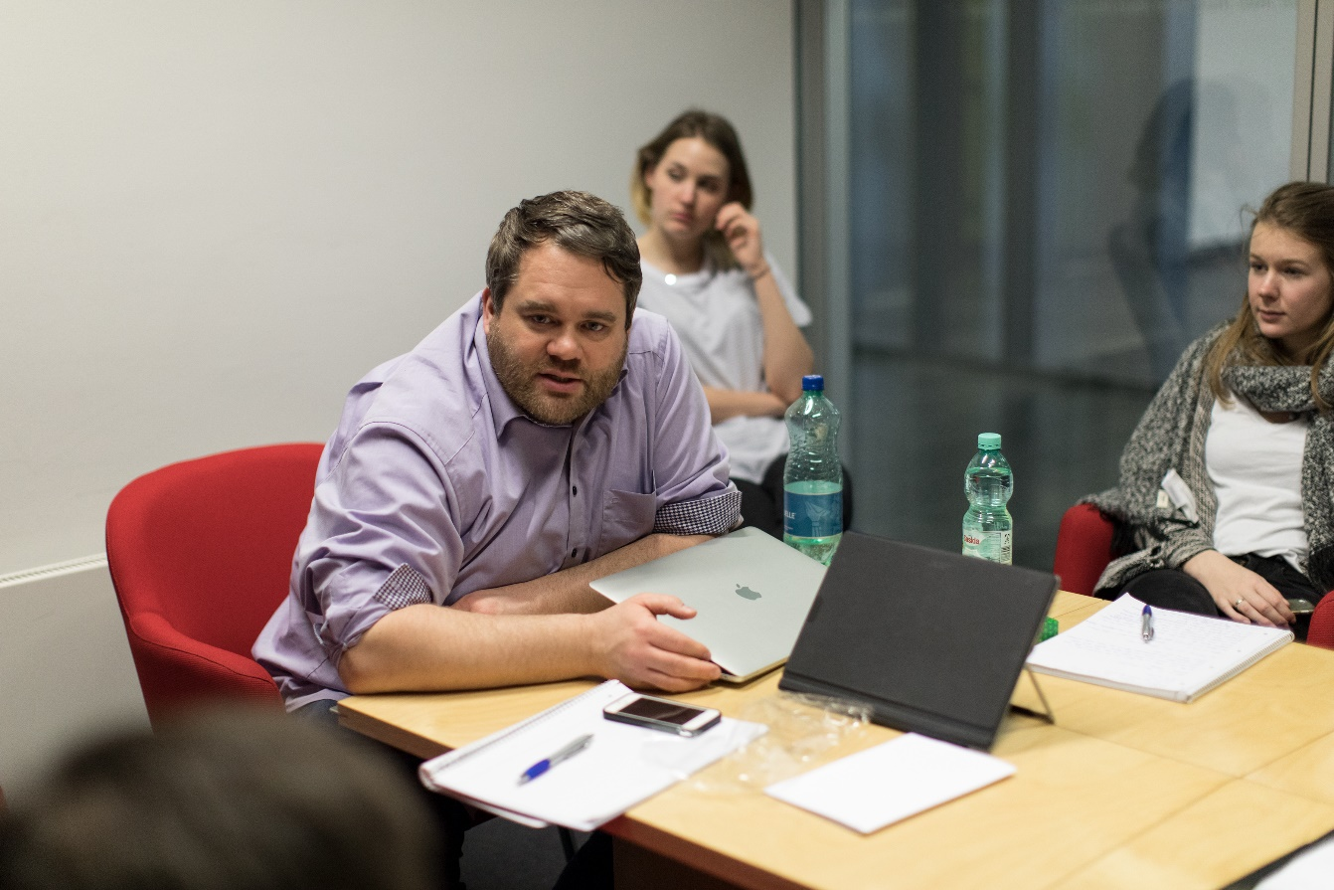
Impressions from previous Radio Days
Credits for the following pictures: THWS
Editorial conference with René

Slide 15
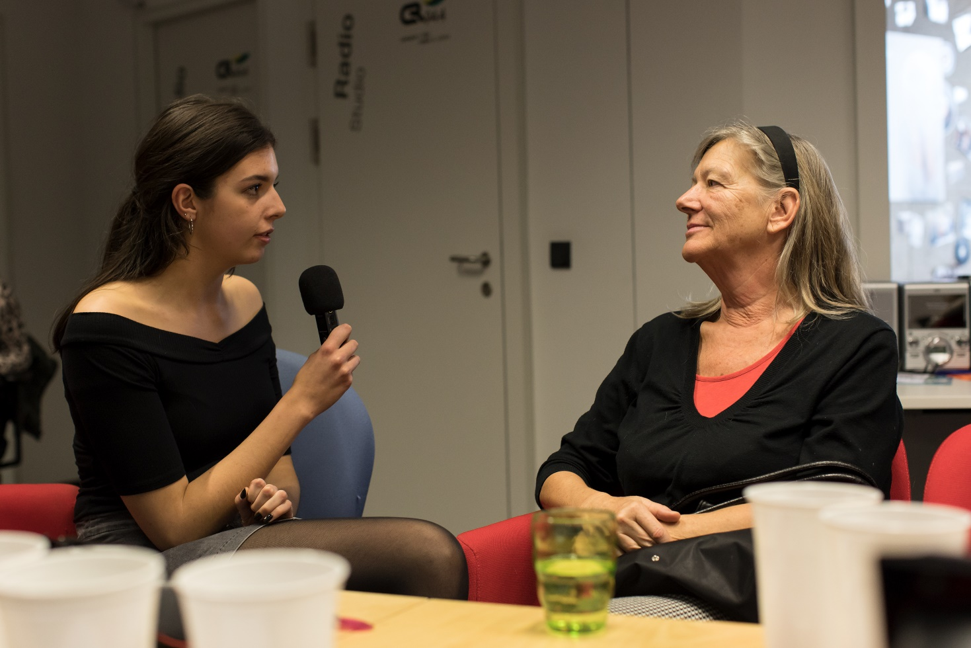
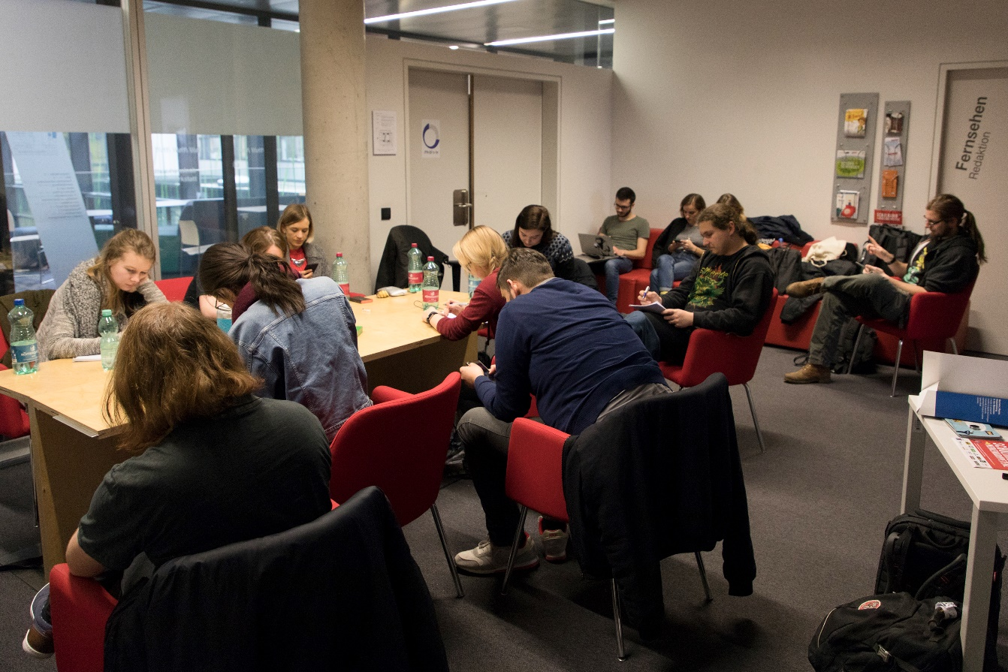
Impressions from previous Radio Days
Interviewing and writing for listening

Slide 16
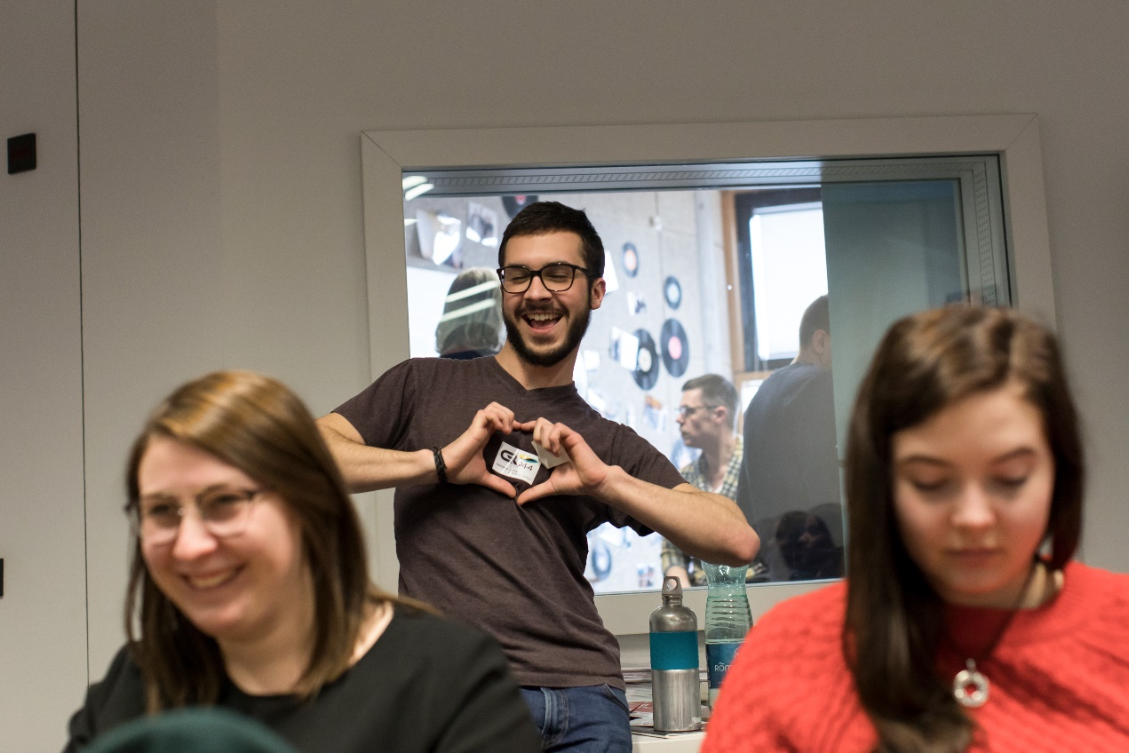
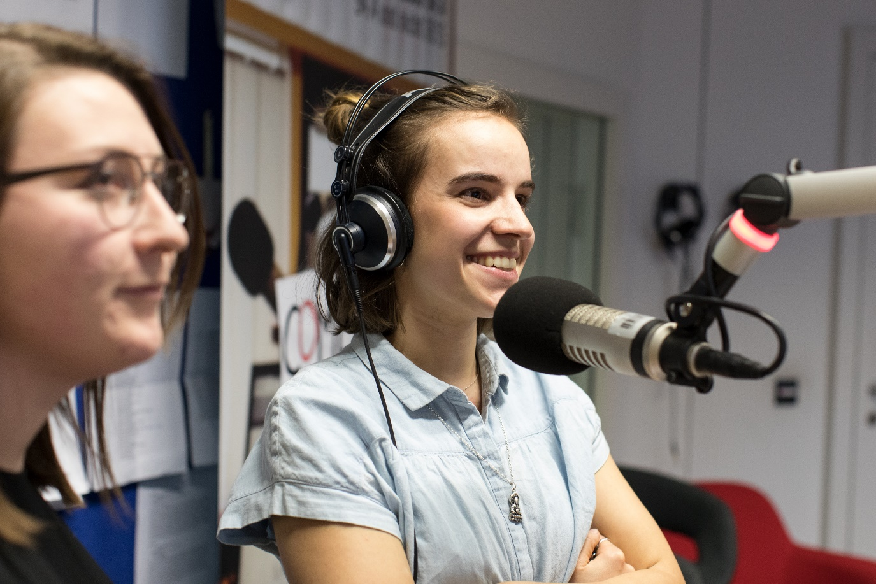
Impressions from previous Radio Days
Radiolove with a view into the studio and @work

Slide 17
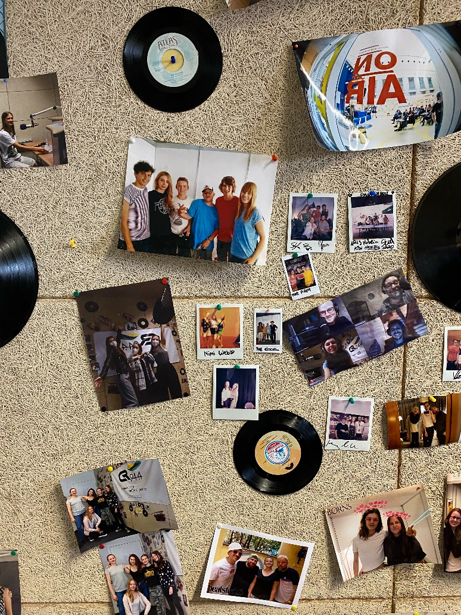
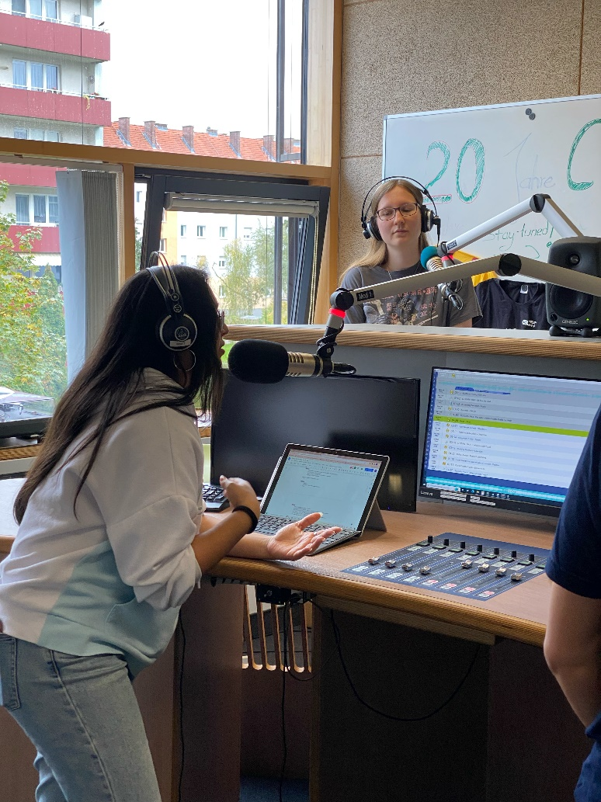
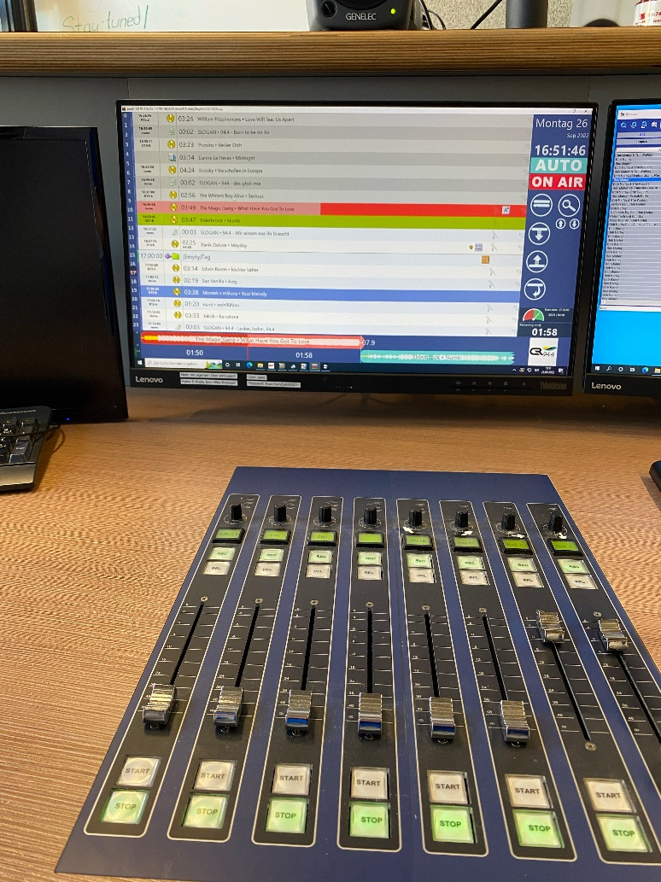
Impressions from previous Radio Days
Studio details

Slide 18
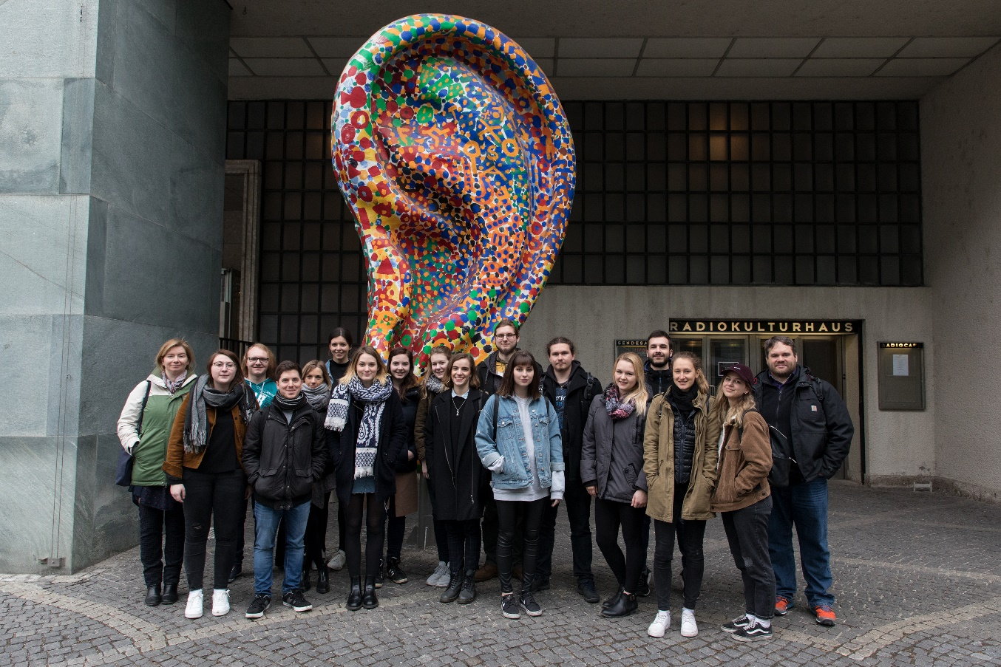
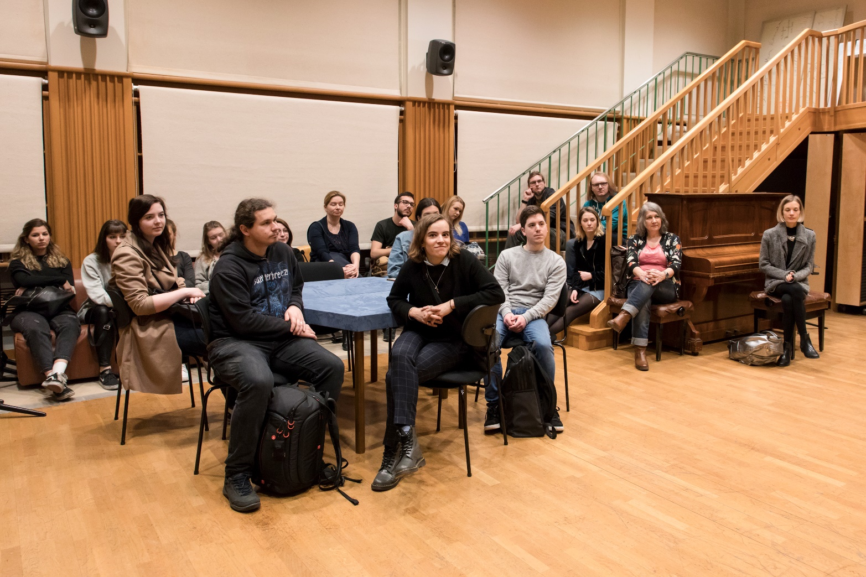
Impressions from previous Radio Days
Field trip to the ORF broadcasting center and its sound lab

